Slide 1

News Analysis
For The Month Of March

Slide 2
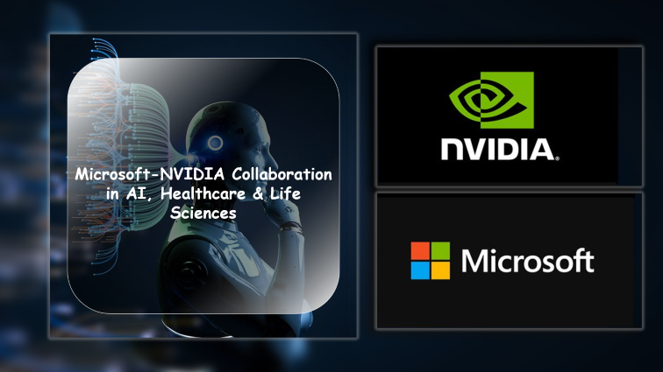
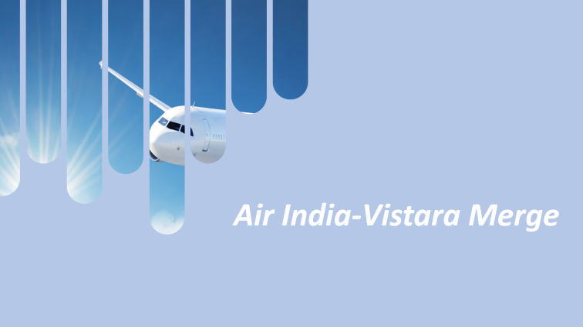
NEWS ANALYSIS HEADLINES

Slide 3

Air India-Vistara Merge

Slide 4

Overview
Air India-Vistara Merger Progress:
Announcement: In November 2022, Singapore Airlines (SIA) and Tata Group announced the merger of Air India and Vistara.
Stake Acquisition: SIA will acquire a 25.1% stake in Air India through this deal.
Completion Timeline: Expected to be completed by mid-2025.
Significance: The merger aims to create India’s largest international carrier, combining valuable slots and air traffic rights from Air India with Vistara’s operational capabilities and customer base.

Slide 5

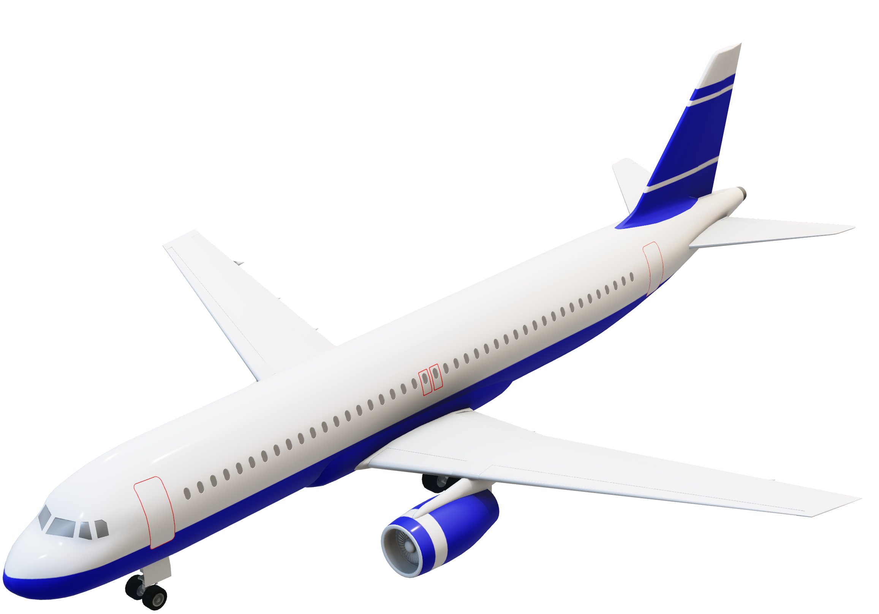
Interpretation:
1
Market Positioning
Combining Air India’s extensive network and Vistara’s premium services, competing more effectively with other airlines.
2
Operational Synergies
The integration of operations, fleet, and crew will lead to cost savings and operational efficiencies.
3
Customer Experience:
Passengers may benefit from improved services, better connectivity, and a wider choice of routes.
4
Regulatory Challenges:
Getting approval from the court and make sure everyone's okay with the merger.

Slide 6
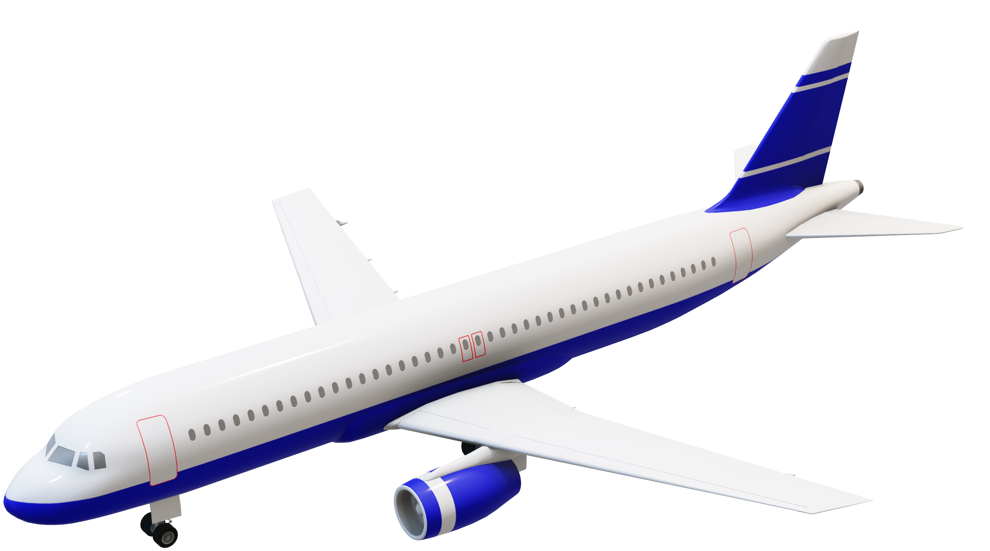
Interpretation:
Observation:
1
Market Positioning
Combining Air India’s extensive network and Vistara’s premium services, competing more effectively with other airlines.
1
Heightened Competition
As airlines restore capacity, competition intensifies, putting pressure on passenger yields.
2
Operational Synergies
The integration of operations, fleet, and crew will lead to cost savings and operational efficiencies.
Geopolitical Tensions and Economic Uncertainty
2
3
Heightened global tensions and economic uncertainty can disrupt air travel and affect passenger demand.
Customer Experience:
Passengers may benefit from improved services, better connectivity, and a wider choice of routes.
3
Operating Cost Challenges
4
Regulatory Challenges:
High fuel prices, inflationary pressures, and supply chain constraints increase the financial burden on airlines.
Getting approval from the court and make sure everyone's okay with the merger.

Slide 7
Observation:
Opinion:
1
Heightened Competition
Positive Outlook
As airlines restore capacity, competition intensifies, putting pressure on passenger yields.
1
The Air India-Vistara merger holds immense potential for India's aviation landscape.
2
Geopolitical Tensions and Economic Uncertainty
2
The combined entity can offer improved connectivity and a compelling travel experience.
Heightened global tensions and economic uncertainty can disrupt air travel and affect passenger demand.
Cautionary Notes
3
Operating Cost Challenges
1
Successful execution of the merger, regulatory approvals, and strategic planning will be critical.
High fuel prices, inflationary pressures, and supply chain constraints increase the financial burden on airlines.
2
Vistara and Air India must prioritize customer satisfaction, operational efficiency, and financial stability.
Predictive Analysis:
1
Market Positioning
Combining Air India’s extensive network and Vistara’s premium services, competing more effectively with other airlines.
2
Operational Synergies
The integration of operations, fleet, and crew will lead to cost savings and operational efficiencies.
3
Customer Experience:
Passengers may benefit from improved services, better connectivity, and a wider choice of routes.
4
Regulatory Challenges:
Getting approval from the court and make sure everyone's okay with the merger.

Slide 8
Observation:
Opinion:
Heightened Competition
Positive Outlook
1
As airlines restore capacity, competition intensifies, putting pressure on passenger yields.
1
The Air India-Vistara merger holds immense potential for India's aviation landscape.
Geopolitical Tensions and Economic Uncertainty
2
The combined entity can offer improved connectivity and a compelling travel experience.
2
Heightened global tensions and economic uncertainty can disrupt air travel and affect passenger demand.
Cautionary Notes
3
1
Successful execution of the merger, regulatory approvals, and strategic planning will be critical.
Operating Cost Challenges
High fuel prices, inflationary pressures, and supply chain constraints increase the financial burden on airlines.
Vistara and Air India must prioritize customer satisfaction, operational efficiency, and financial stability.
2

Slide 9


Microsoft-NVIDIA Collaboration in AI, Healthcare & Life Sciences

Slide 10






The collaboration aims to enhance patient care by:
Accelerating Clinical Research: AI-driven insights will become more accessible, allowing researchers to explore novel hypotheses and identify promising drug candidates.
Improving Diagnostics: Medical image-based diagnostic technology will aid early disease detection and personalized treatment.
Enabling Precision Medicine: Tailoring treatments to individual patients based on genetic and clinical data.
Microsoft and NVIDIA have joined to accelerate innovation in healthcare and life sciences by leveraging generative AI, cloud computing, and accelerated computing.
By combining Microsoft Azure's global scale and advanced computing capabilities with NVIDIA's DGX Cloud and Clara suite, they aim to accelerate innovation and improve patient care.
Their collaboration targets various areas such as clinical research, drug discovery, and medical image-based diagnostics, with the goal of enhancing precision medicine and making healthcare more accessible and effective globally.
They're also working on faster genomics analysis, which could lead to better understanding and treatment of genetic disorders
Opinion
Interpretation

Slide 11
Market Reaction: Companies involved may see an increase in stock prices, while competitors might face pressure to innovate or form similar partnerships to stay competitive.
Global Impact: Benefiting patients worldwide, especially in underserved regions.
Economic Growth: By fostering innovation, this collaboration may contribute to economic growth in the healthcare sector.
Ethical Considerations: Striking a balance between technological advancements and patient privacy is crucial.
The collaboration aims to enhance patient care by:
Accelerating Clinical Research: AI-driven insights will become more accessible, allowing researchers to explore novel hypotheses and identify promising drug candidates.
Improving Diagnostics: Medical image-based diagnostic technology will aid early disease detection and personalized treatment.
Enabling Precision Medicine: Tailoring treatments to individual patients based on genetic and clinical data.
Opinion
Interpretation
Microsoft and NVIDIA have joined to accelerate innovation in healthcare and life sciences by leveraging generative AI, cloud computing, and accelerated computing.
By combining Microsoft Azure's global scale and advanced computing capabilities with NVIDIA's DGX Cloud and Clara suite, they aim to accelerate innovation and improve patient care.
Their collaboration targets various areas such as clinical research, drug discovery, and medical image-based diagnostics, with the goal of enhancing precision medicine and making healthcare more accessible and effective globally.
They're also working on faster genomics analysis, which could lead to better understanding and treatment of genetic disorders

Slide 12
Optimistic Outlook: This collaboration represents a significant stride toward revolutionizing healthcare.
Cautious Enthusiasm: While promising, challenges remain in implementation and data privacy. Vigilance is necessary.
Patient-Centric Focus: Patient outcomes should be at the forefront of decision-making throughout this collaboration.
Long-Term Vision: The impact of this collaboration may extend beyond immediate gains, shaping the future of healthcare
Market Reaction: Companies involved may see an increase in stock prices, while competitors might face pressure to stay competitive.
Global Impact: Benefiting patients worldwide, especially in underserved regions.
Economic Growth: By fostering innovation, this collaboration may contribute to economic growth in the healthcare sector.
Ethical Considerations: Striking a balance between technological advancements and patient privacy is crucial.
Interpretation
Opinion
The collaboration aims to enhance patient care by:
Accelerating Clinical Research: AI-driven insights will become more accessible, allowing researchers to explore novel hypotheses and identify promising drug candidates.
Improving Diagnostics: Medical image-based diagnostic technology will aid early disease detection and personalized treatment.
Enabling Precision Medicine: Tailoring treatments to individual patients based on genetic and clinical data.

Slide 13
Optimistic Outlook: This collaboration represents a significant stride toward revolutionizing healthcare.
Cautious Enthusiasm: While promising, challenges remain in implementation and data privacy. Vigilance is necessary.
Patient-Centric Focus: Patient outcomes should be at the forefront of decision-making throughout this collaboration.
Long-Term Vision: The impact of this collaboration may extend beyond immediate gains, shaping the future of healthcare
Opinion
Interpretation
Market Reaction: Companies involved may see an increase in stock prices, while competitors might face pressure to innovate or form similar partnerships to stay competitive.
Global Impact: Benefiting patients worldwide, especially in underserved regions.
Economic Growth: By fostering innovation, this collaboration may contribute to economic growth in the healthcare sector.
Ethical Considerations: Striking a balance between technological advancements and patient privacy is crucial.

Slide 14



THANK YOU!

